Slide 1

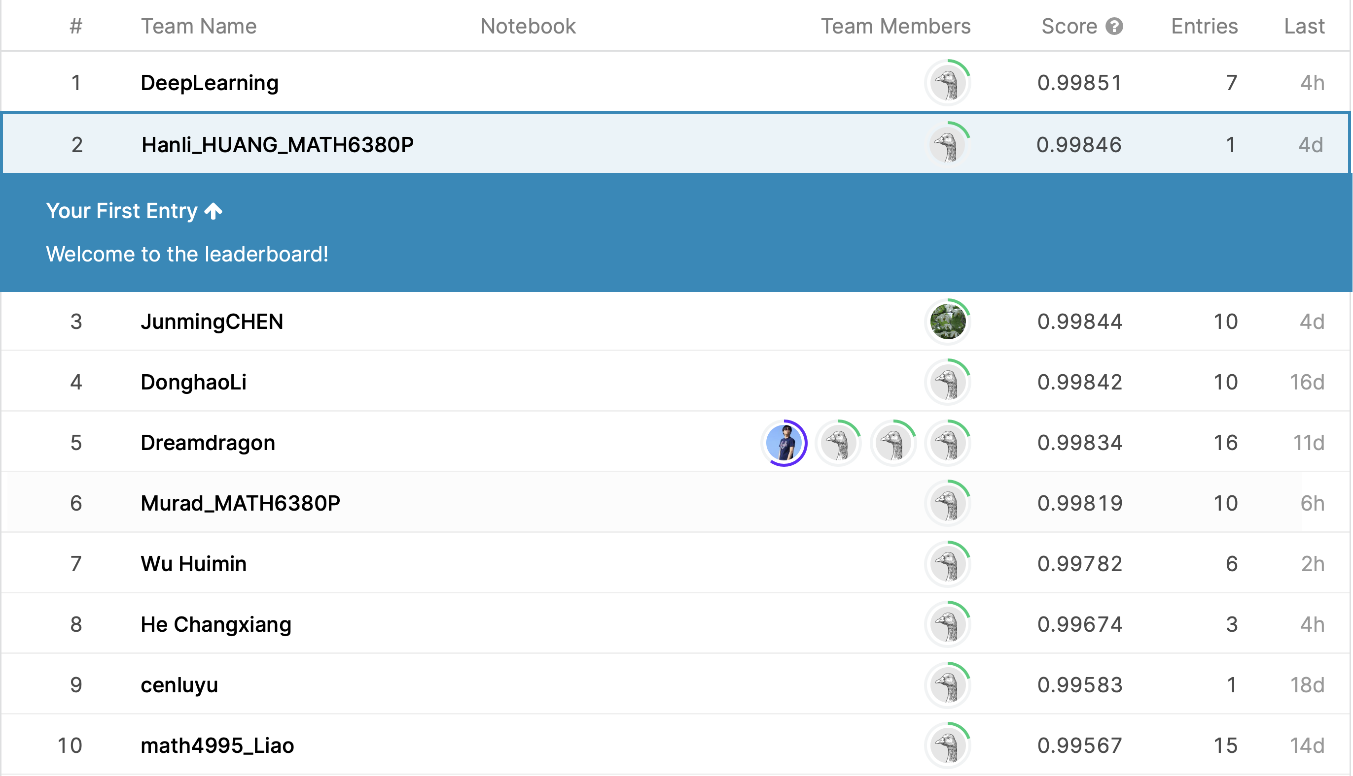
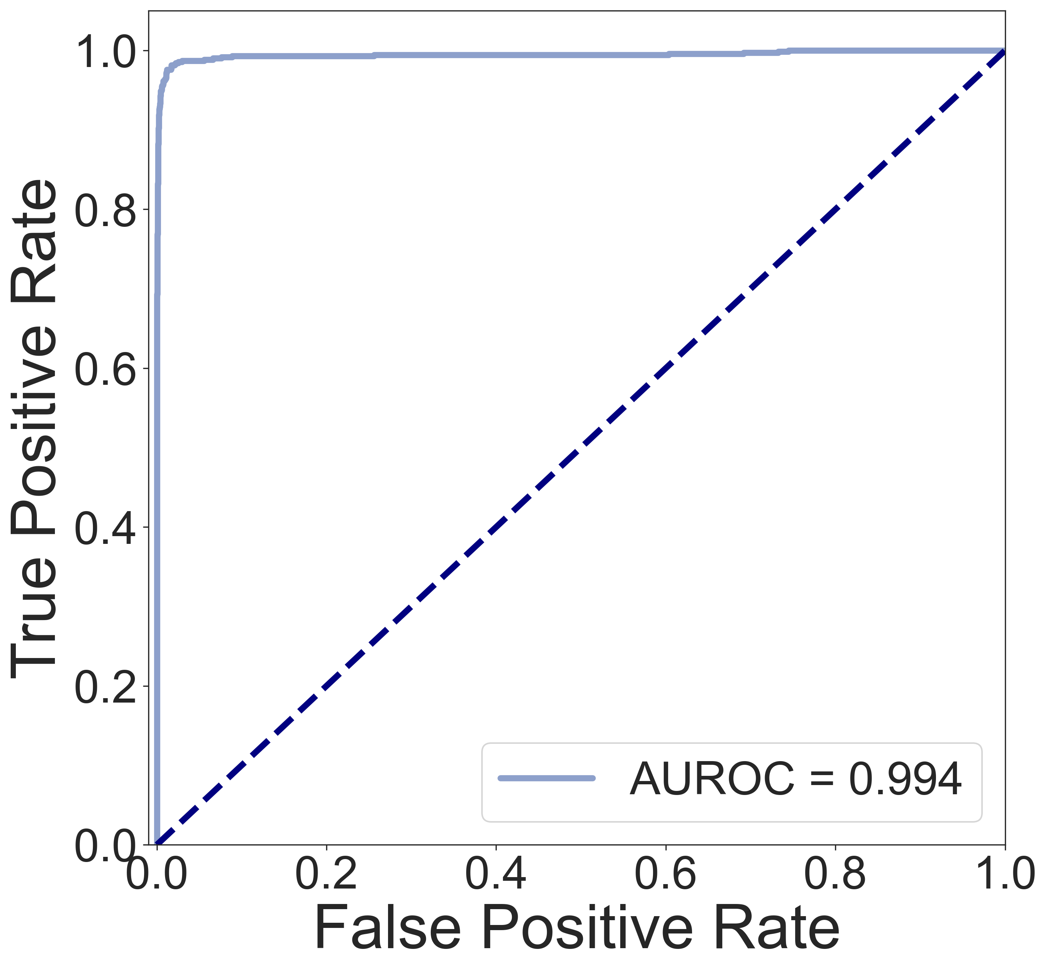
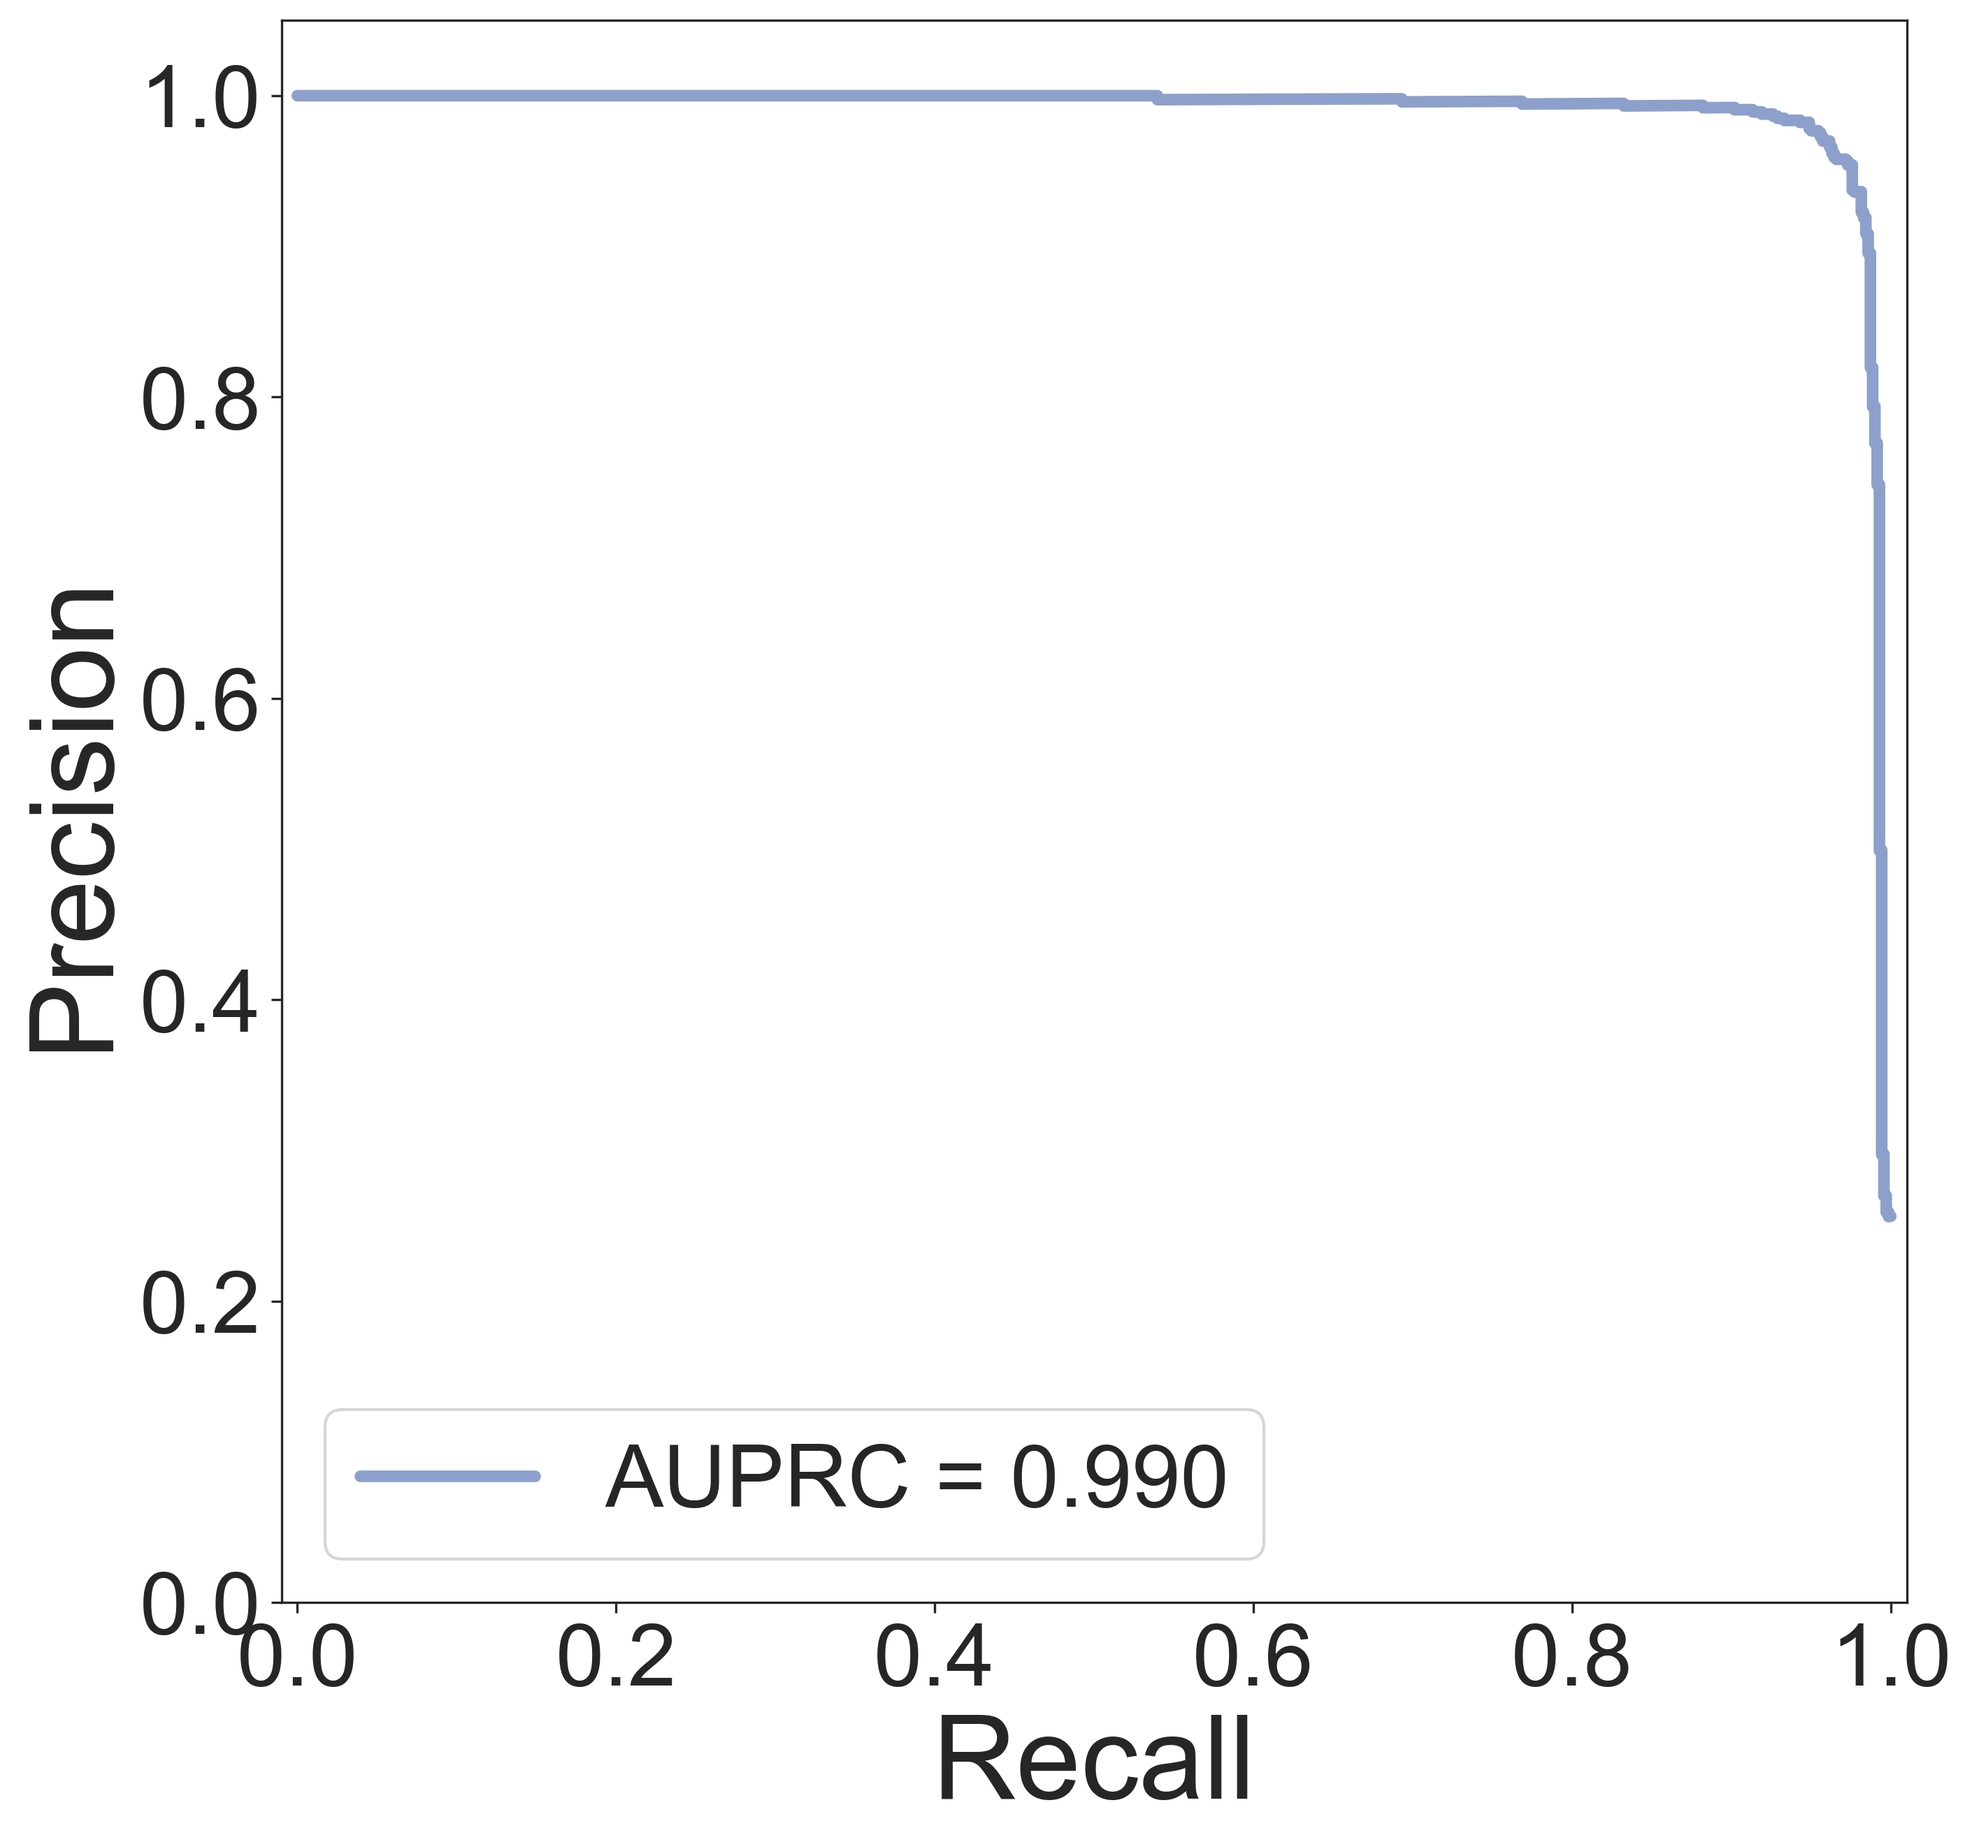
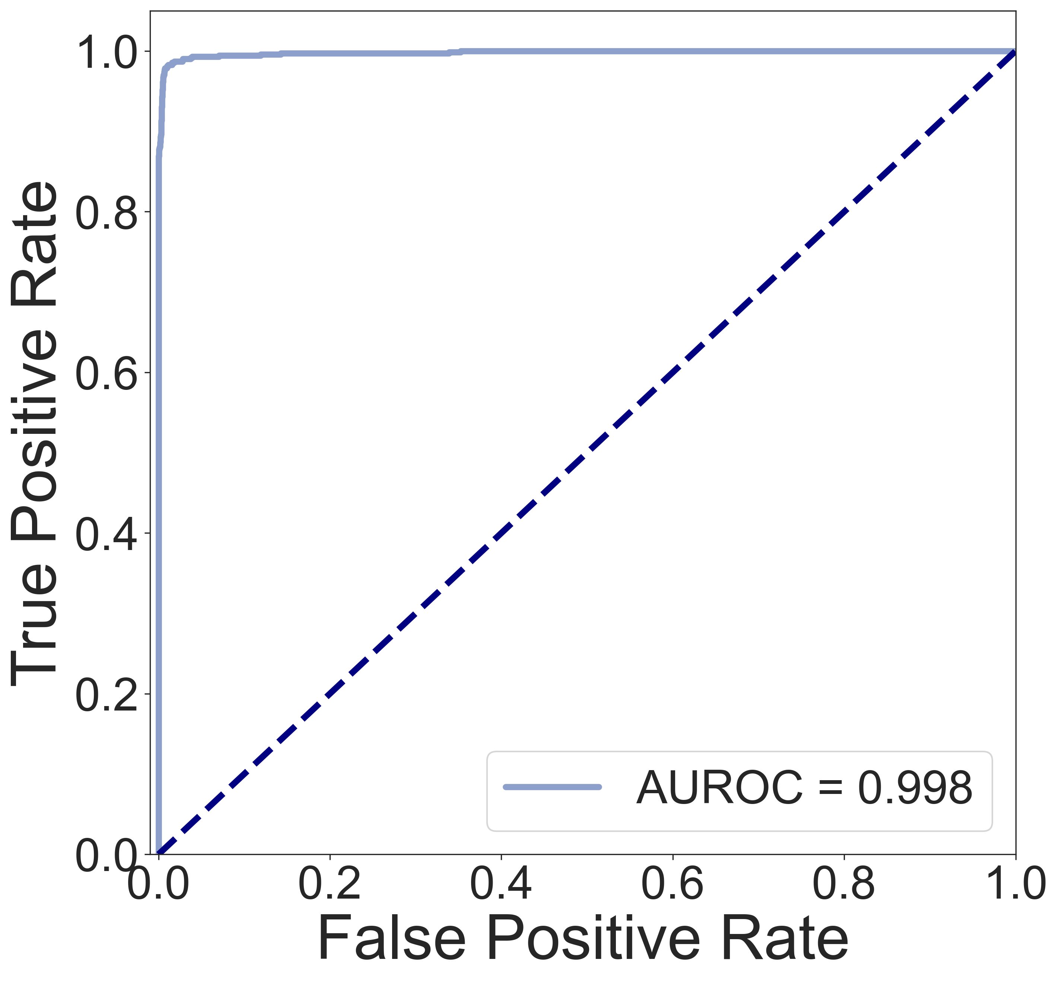
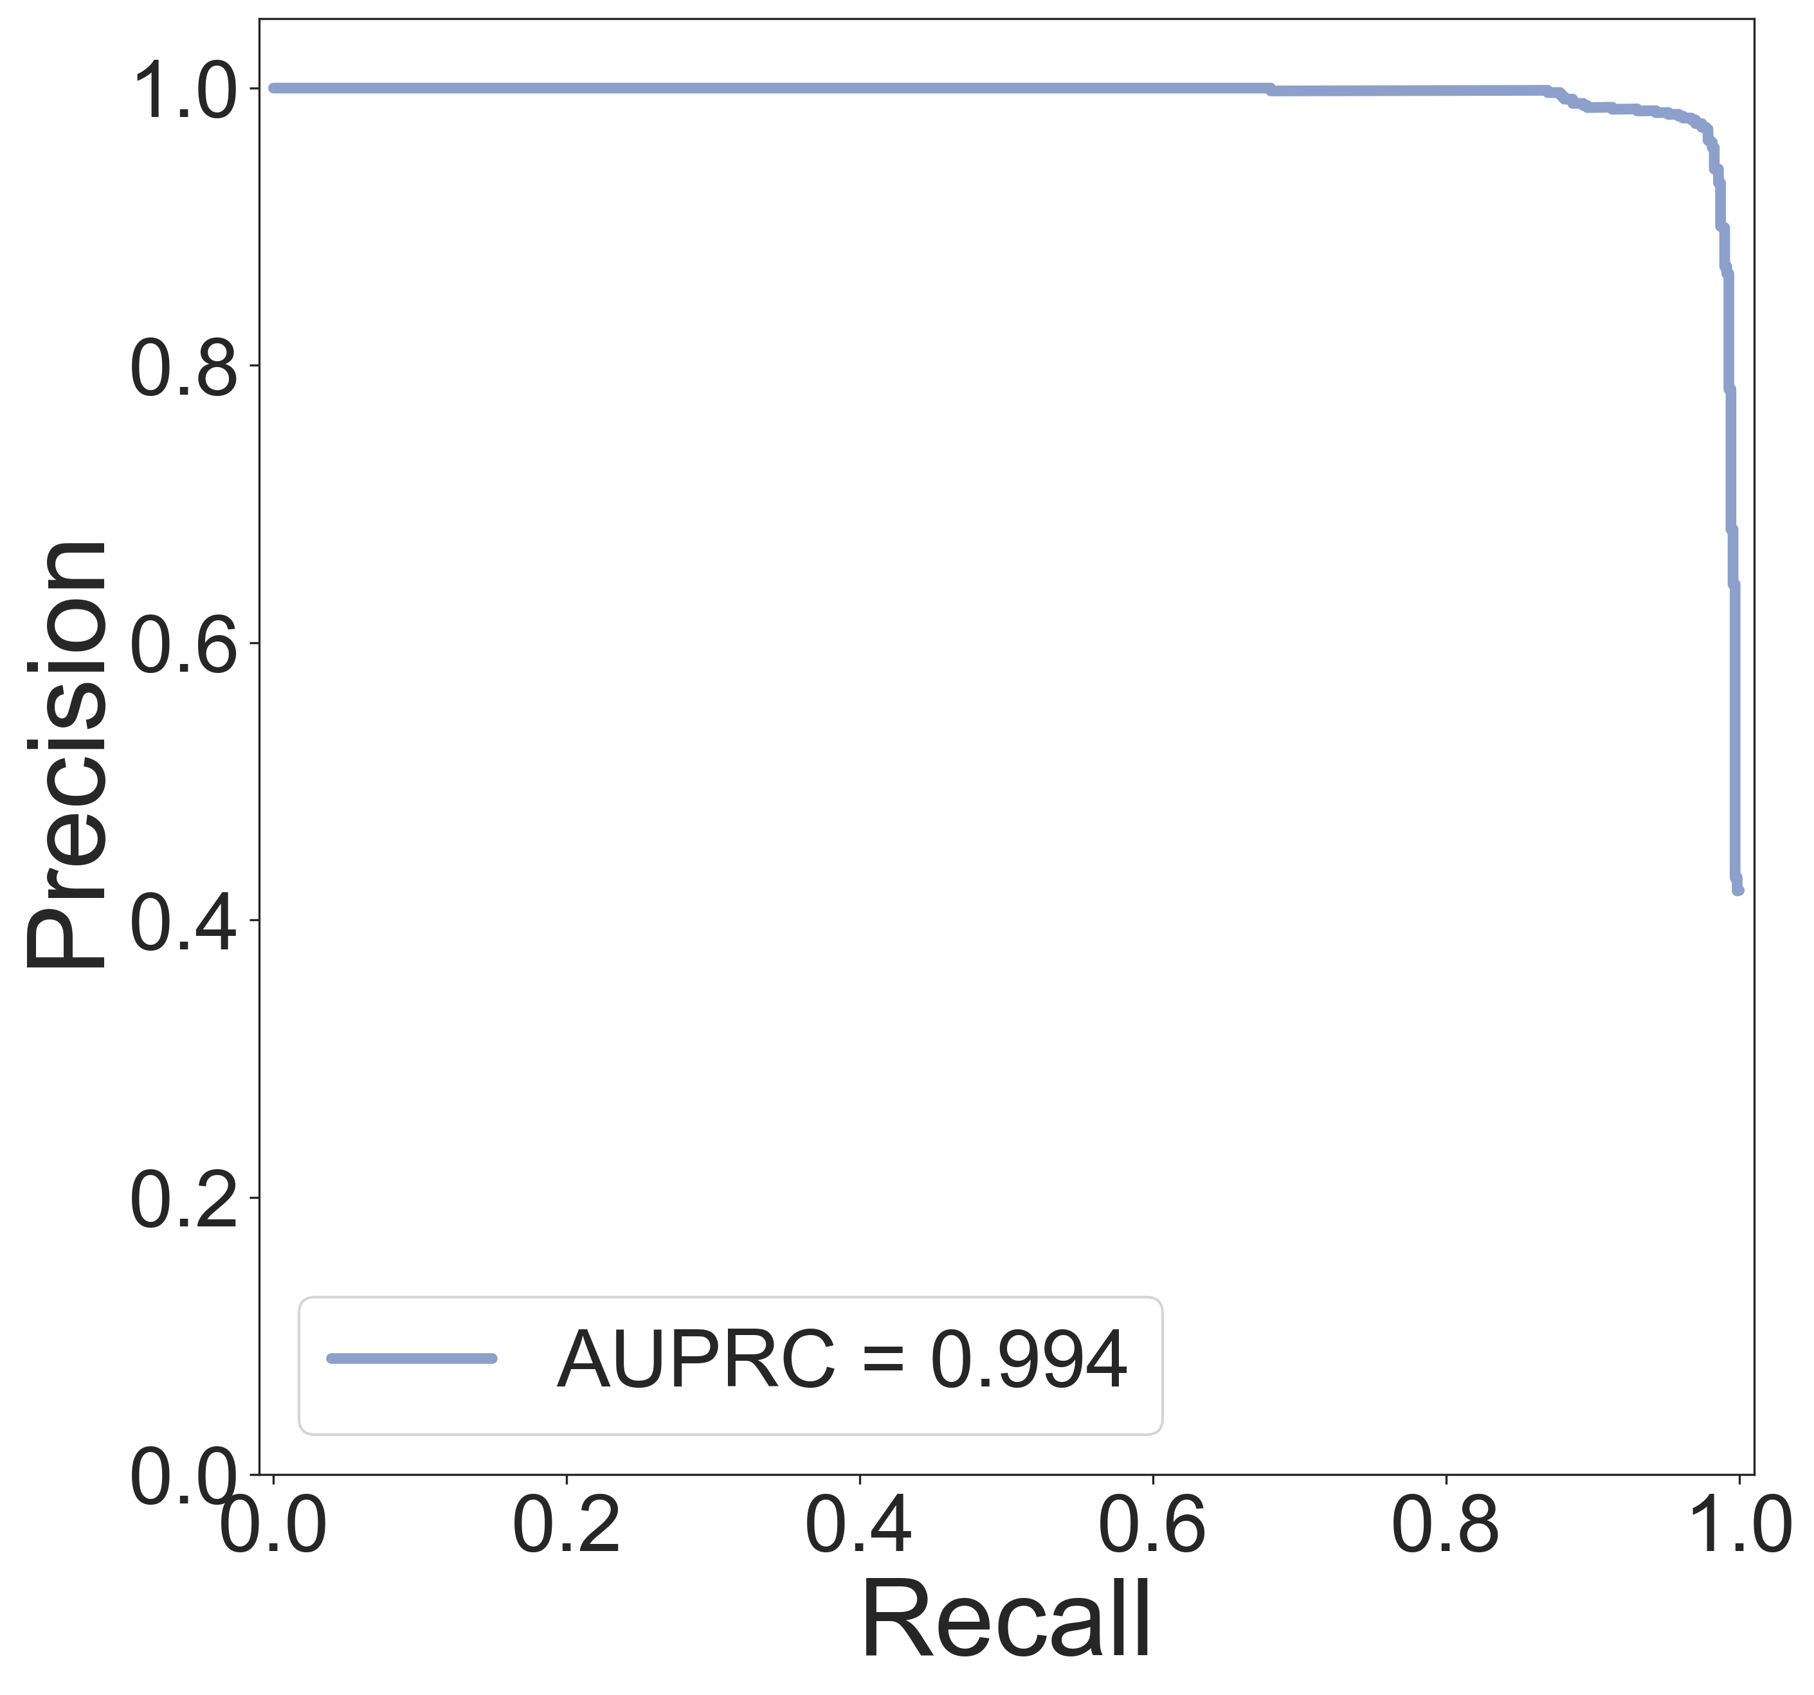
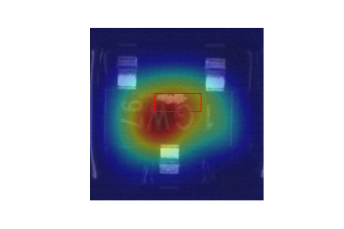
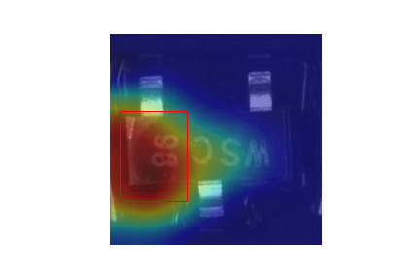
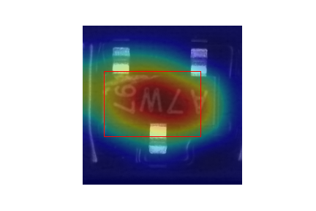
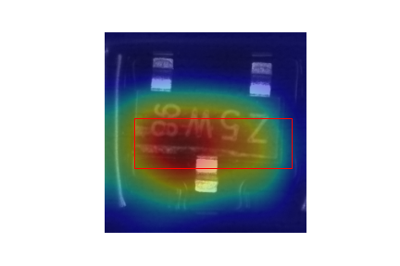
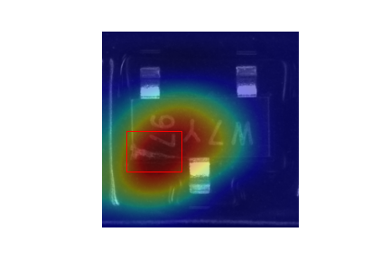
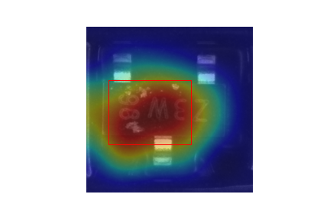
Semi-conductor defect images classification
Hanli Huang
Presented by
HKUST
Department of Bioengineering
Introduction
Results
Results
Nexperia is one of the biggest Semi-conductor company in the world. A lot of unqualified devices are mixed with the good one in the billions of products every year. It is difficult for human workers to manually examine all these products. Meanwhile, the examine accuracy can not keep high level because of human workers’ state fluctuations.
The goal of this study is to train a classifier that can identify defect and good images of semiconductor devices. The key point of this task is that the imbalance of two class. We would like to detect all defect images while not sacrificing too many passed ones. Another noted phenomenon is that there are some noisy labels, especially in the good class. In this study, pre-trained convolutional neural networks are used to train classifiers to detect the defect images. To further evaluate the accuracy, Grad-CAM is applied to visualize the attention areas that the model used to make the decision whether an image is good or defect.
Results
Part 1. Performance of pre-trained models
Part 2. Performance on the Kaggle test dataset
A1
A2
Here I mainly compared the performance of basic pre-trained InceptionResNetV2 model and class weight adjusted model. As we noted, the two class of the dataset are imbalance, and we will focus on the defect class more. Meanwhile, the noisy labels are much less in the defect class. Then I tried to add weight adjust during the model training to increase the sample weights of defect class. During the models training, randomly rotation, shifting, shearing and flipping were applied to increase the robust of the models. All the evaluation was calculated on the model-validation dataset that I mentioned in the Dataset part before which include 3444 images. A1 and A2 show the ROC and PRC curve of basic model and B1 and B2 are the weight adjusted model. Basic model has achieved a quite high accuracy with the AUROC of 0.994 and AUPRC 0.99, while the weight adjust still improved the performance to 0.998 and 0.994. Due to the training time, I didn’t try a lot of weight ratio between defect and good class. The result shows here is adjusted as 10:1 (defect versus good).
As we would like to detect as many defect images as possible while not sacrificing too many passed ones, I checked the False Positive Rate (FPR) of the predictions when use different True Positive Rate (TPR). The table on the left side shows the comparison of two models’ results. The result indicates that if we add weight adjust, the sacrificing would be reduced significantly when keep high TPR.
Fig. C shows 6 examples of the Grad-CAM visualization results. The red rectangles are the defect areas that provided by dataset. The red heatmap shows the attention areas the model used to predict these images as defect ones. As we can see, the model successfully payed more attention on the real defect areas which increase the trust of the prediction results.
B1
B2
Then I applied the weight adjust model on the Kaggle test dataset. As we didn’t have the ground truth of this dataset, the Kaggle only reported a ROC score of 0.99846. Until 11th DEC, my model got the second place on the Kaggle competition.
Dataset
Conclusion and Future Works
Dataset
In this project, I compared performance of the basic InceptionResNetV2 model and weight adjust model in the task of detecting the defect semi-conductor images. The high ROC and PRC results indicates that the model can successfully detect most defect image, and weight adjust can further improved the performance. If I could run more experiments, there might be better performance. The Grad-CAM visualization shows a clear attention map that model really detect the right areas for the task.
As Prof.Yao mentioned in the class, another problem of this task is batch effect. When the model was applied on another dataset that the images were token on different environment, the prediction would be quite bad. One possible approach for this problem could be adding some noise into the original images or using some images that token by different device with different environment as standard images to normalize the original images and new coming images to same gray or color space. Here we didn’t have different batch of images that let this experiment difficult to evaluate.
The dataset consists of 34457 train images (27420 good and 7039 bad) and 3830 test images. All the images are gray scale and have a same size of 275X267 pixels. I further separated the training dataset into 3 datasets. Model-training (24121 images with similar good-defect ratio) and model-testing (6892 images with similar good-defect ratio) were used for model training. Model-validation (3444 images with similar good-defect ratio) were used to fine-tune the hyper-parameters.
 | FPR (Basic) | FPR (Weight adjust)
TPR>0.9 | 0.18% | 0.33%
TPR>0.95 | 0.55% | 0.44%
TPR>0.99 | 6.6% | 2.8%
Methodology
Part 1: InceptionResNetV2^{[1]}
InceptionResNetV2 is developed by Google in which they combined the Inception architecture with residual connections. This network achieved 3.08 percent top-5 error on the test set of the ImageNet classification challenge.
Part 2: Grad-CAM^{[2]}
Grad-CAM is a technique for producing “visual explanation” for decisions from a CNN-based model.
It helps users establish appropriate trust in predictions from models. In this study, I used this approach to compare the attention area with defect positions that provided by the dataset.
C
Part3. Classification performance with Deep learning
References
1. Christian Szegedy, Sergey Ioffe, Vincent Vanhoucke, Alex Alemi. Inception-v4, Inception-ResNet and the Impact of Residual Connections on Learning. arXiv:1602.07261v2.
2. Ramprasaath R. Selvaraju, Michael Cogswell, Abhishek Das, Ramakrishna Vedantam, Devi Parikh, Dhruv Batra. Grad-CAM: Visual Explanations from Deep Networks via Gradient-based Localization. arXiv:1610.02391

